Slide 1

Accurate Snow Simulation
Colter Snyder and Elijah Mt. Castle

Slide 2
Background
We have used tessellation shaders for heightmaps
What if we could use them for depressions in the ground?

Slide 3
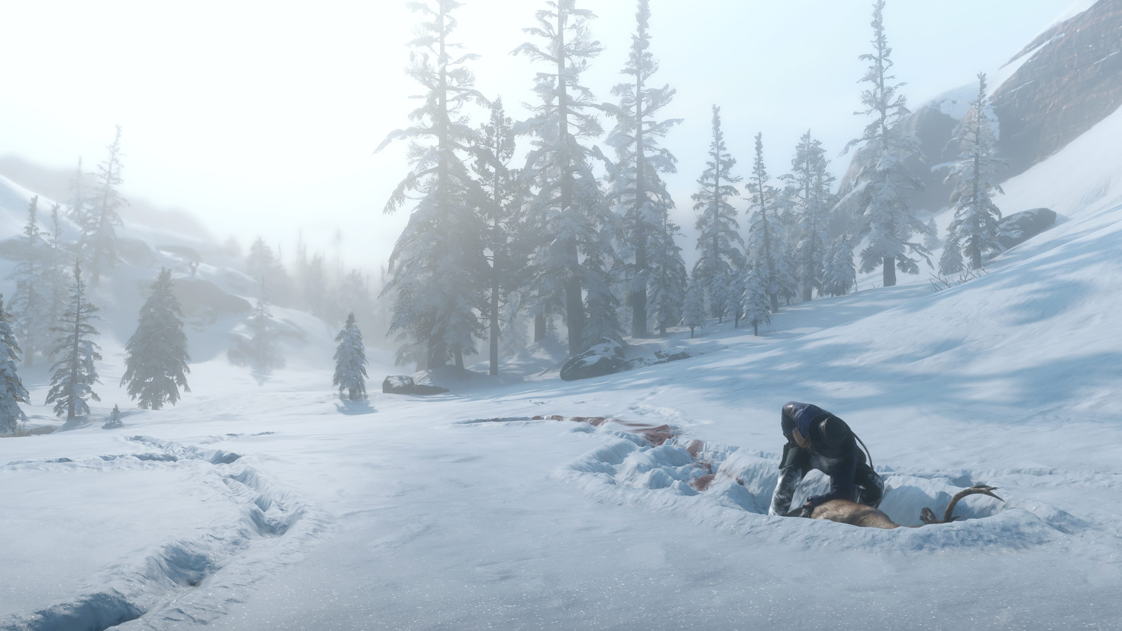
Inspiration
Red Dead Redemption 2
Fantastic Snow Physics
Other Games with Great Snow/Mud Physics
Snow Runner
Mud Runner
Image Source: https://i.redd.it/2g9njmrqq7o11.jpg

Slide 4
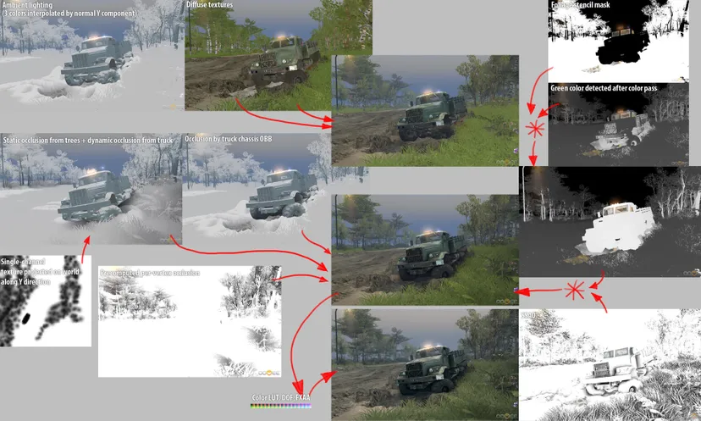
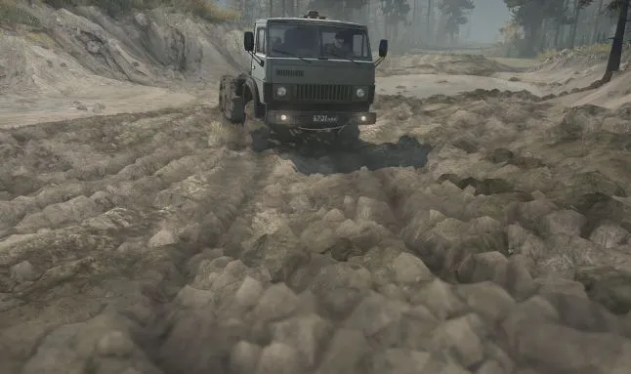
Inspiration
Source: https://www.gamedeveloper.com/programming/rendering-and-simulation-in-offroad-driving-game#close-modal
https://www.gamedeveloper.com/programming/mud-and-water-of-spintires-mudrunner#close-modal

Slide 5
Implementations
Similar to the height map!
Two Options:
Make the height map have slight variation based on small changes to the color of the texture
Have a separate texture to show the displacement due to depressions in snow and/or mud
Easiest solution!

Slide 6
Our Implementation
Our implementation uses a texture such that black is fully depressed and white is original height.
Depression height set in texture

Slide 7
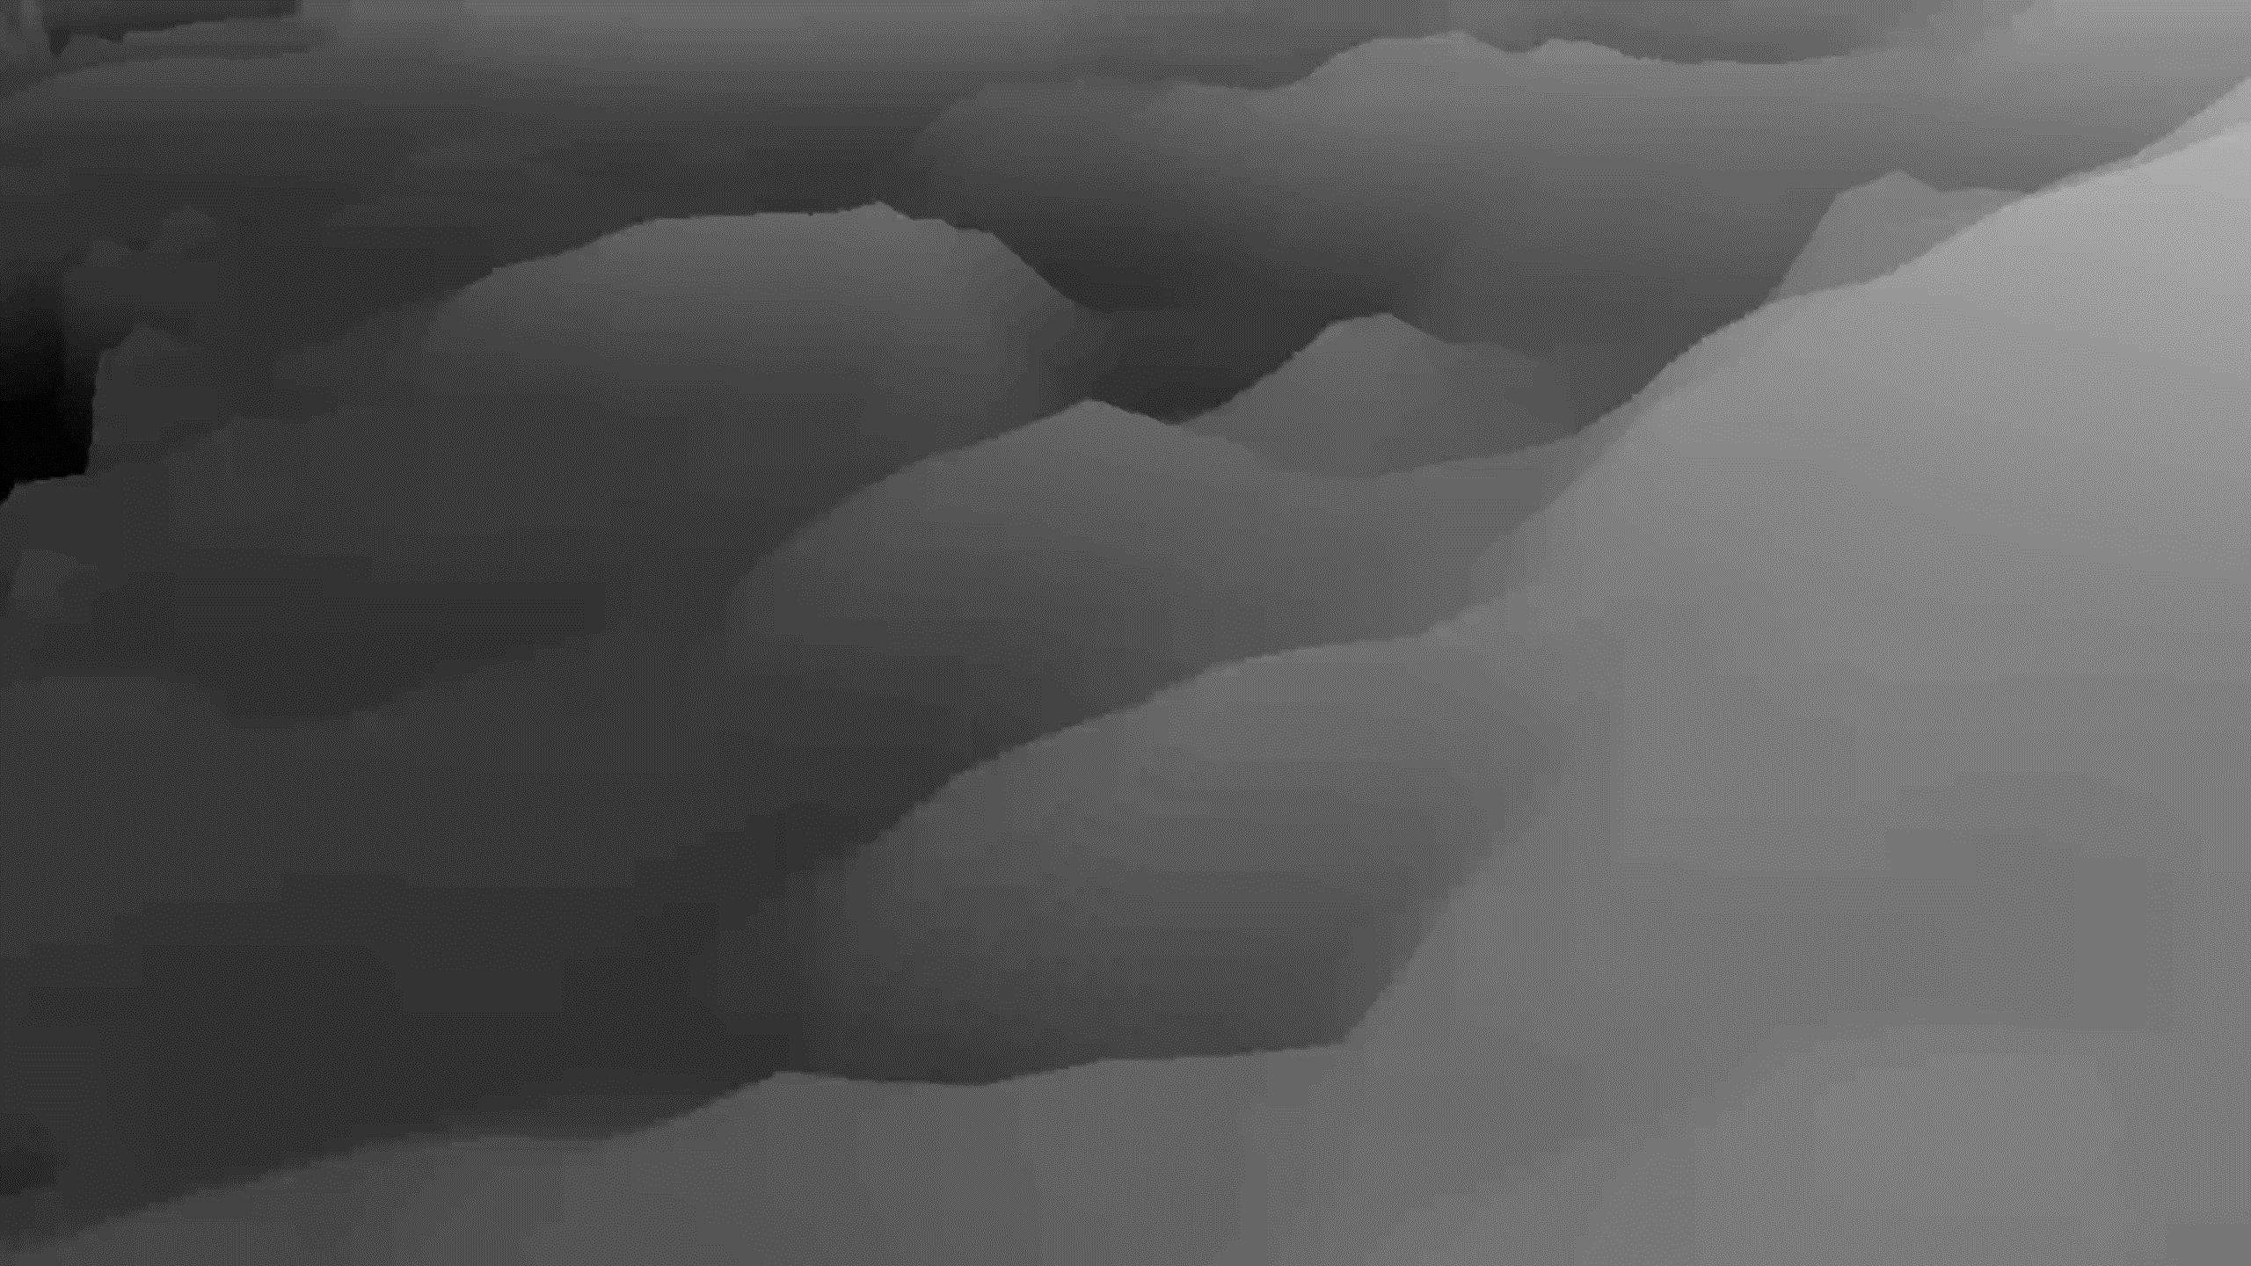

Demo

Slide 8
Sources
https://www.gamedeveloper.com/programming/rendering-and-simulation-in-offroad-driving-game
https://www.gamedeveloper.com/programming/mud-and-water-of-spintires-mudrunner
https://www.gamedev.net/forums/topic/700247-snow-physics-in-red-dead-redemption-2/5396779/

